Slide 1
Bollinger Band

Slide 2
Bollinger Band
A buy signal is generated when the candlestick data reaches oversold
A sell signal is generated when it reaches overbought.
The core concept behind the BB indicator is to highlight how prices are dispersed around an average value.
When the price continually touches the upper Bollinger Band, it can indicate an overbought signal.
If the price continually touches the lower band it can indicate an oversold signal.

Slide 3
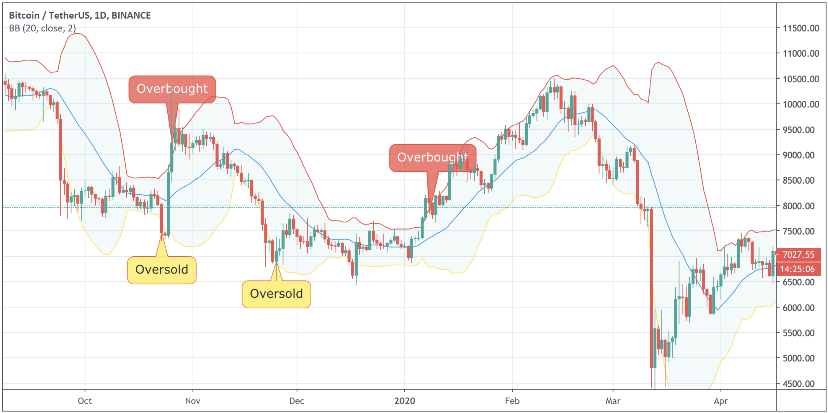

Slide 4
More specifically, it is composed of an upper band (red), a lower band (yellow), and a middle band (blue), also known as the middle moving average line. Middle line = (SMA, n) Upper band = (SMA, n) + (standard deviation * y) Lower band = (SMA, n) - (standard deviation * y) Where: n = Time Period y = standard deviation multiplier In our case, it is 2.

